Slide 1
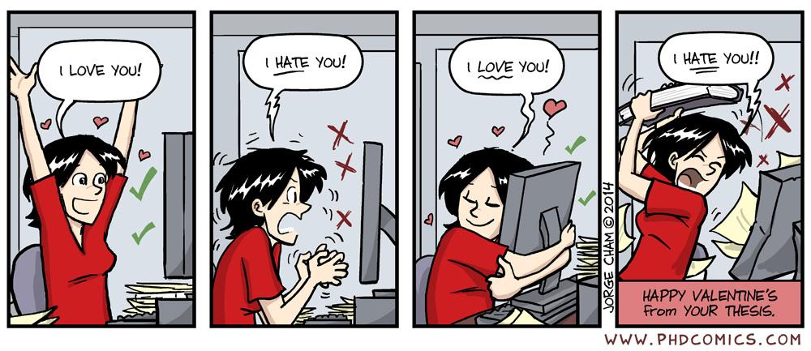
User interface design
xkcd

Slide 2
UI Design: Friday Sept 30
Dr. Jillian Aurisano
Plan for today:
Announcements/Course logistics
People- part 1
Activity- project activity
Notes:
So welcome to engineering visual interfaces for data science. I'm Dr Aurisano.
Thanks for finding the class on Zoom. Hopefully we will be in person again soon.
If anyone out there is comfortable turning on their cameras, that is lovely- then I feel like I am talking to students, rather than to myself.
Here’s our plan for today:
First I’m going to introduce myself, so you know a bit about me
Then we are going to get to know each other, in Zoom breakout rooms. This will give us a chance to make sure that Zoom breakout rooms work, and we all know how to access them.
Then, I am going to walk through the structure, and plan for the course. I want to make sure everyone knows how the course will work, and what to expect, and also a bit about why the course is designed this way.
Then I am going to introduce the class, and what the class is about. Since this is a new class, and one of just a few classes in human centered computing here at UC, I wanted to give an overview of the topic.
Then I have an introductory activity, which we will do in breakout rooms, and which I think will help motivate the discussion on Wednesday, and getting into the meat of the class.

Slide 3
Project deadline updates

Slide 4
Clarifying the project goals
What is a ‘C-level’ basic interface vs ‘More complex inputs’ (one of the A/B options)
How to go deeper on data or user profiles
No expectation that you develop complex data visualizations
But, you are free to use external visualization libraries
Or use svg to make simple graphics
How to simulate
Think of this as a test of your UI
It is ok to use a simplified example
Ex. Grocery store is a rectangle, with 50 products along that rectangle, user has a list of 5 items
Run under localhost, not served on your documentation portfolio site (wix, google sites)
Please keep asking questions!

Slide 5
Let’s talk about people
We’ve talked a bit about people in a couple of contexts already
Perception and gestalt principles
Color perception
Attention and scanning – need for hierarchy and spatial clustering
Affordances:
door handles want to be pulled, buttons want to be clicked on
Usability- learnability, efficiency, safety/errors
People learn by doing
Let’s look a bit more closely at our human users of the interfaces we are building

Slide 6
Understanding people
How we see, think, listen, remember, decide…
This is determined by the structure and operation of our brain
Some activities we do effortlessly
Some activities we struggle with
Understanding how our brains work, will help us design better interfaces that works better with people

Slide 7
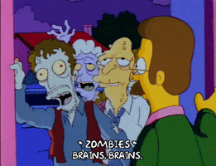
Brains!!!

Slide 8
Our brains interpret reality
Our brains interpret what the visual system brings in
Our brains impose structure, where it thinks structure is appropriate
This is influenced by ‘priors’ (our experiences)
We have a model of the world
We try to fit what we see into this model

Slide 9
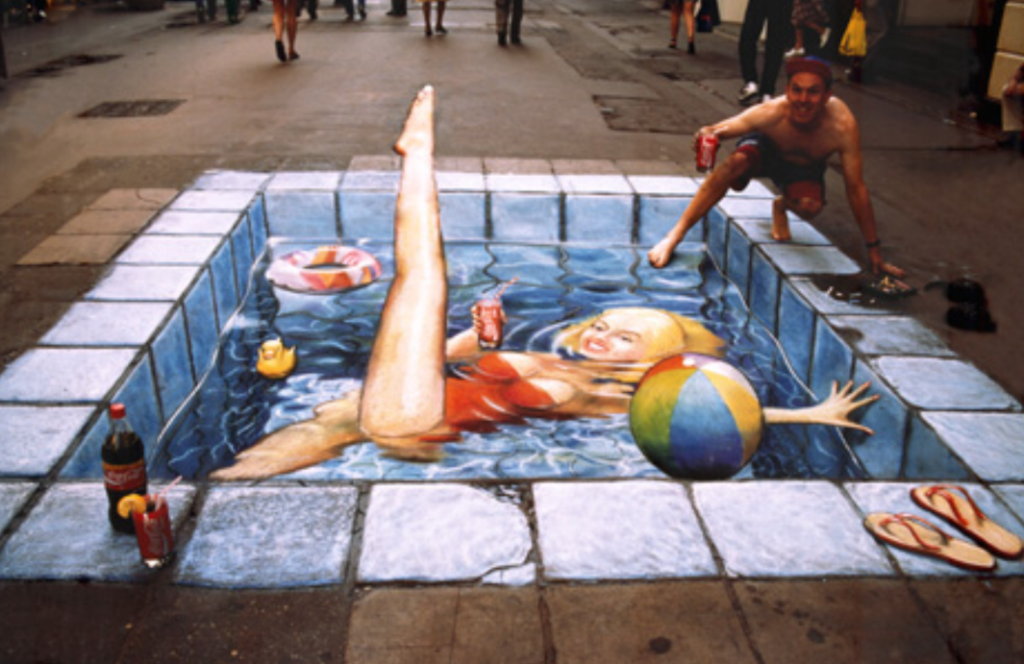
What we see

Slide 10
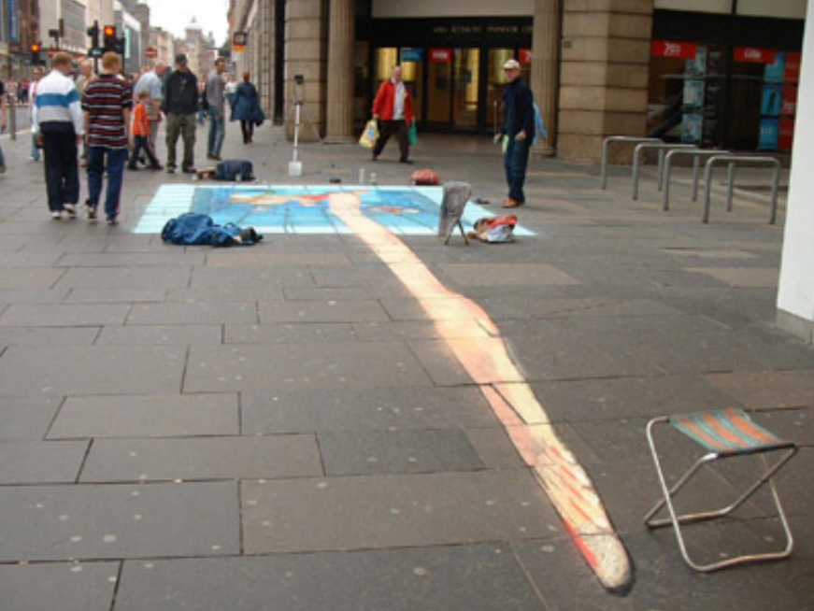
What is there

Slide 11
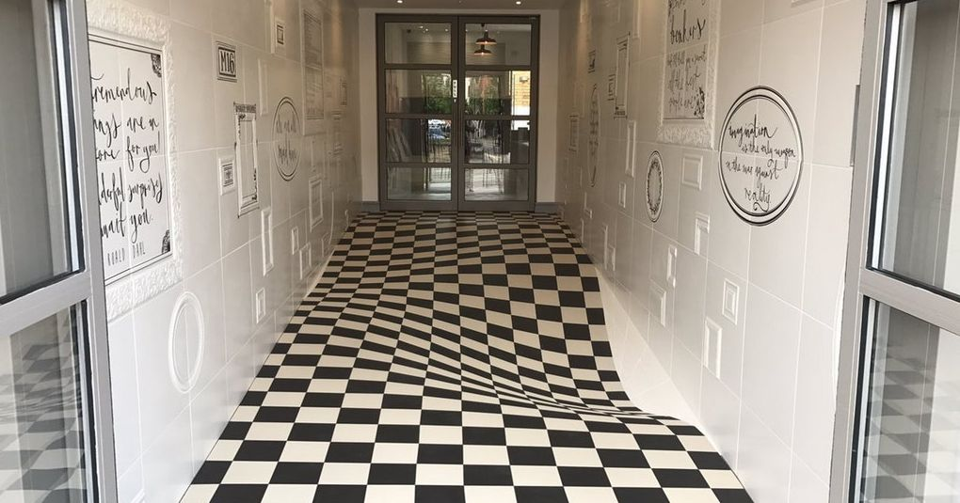
Do you want to walk on this floor? Checkered tile illusion

Slide 12
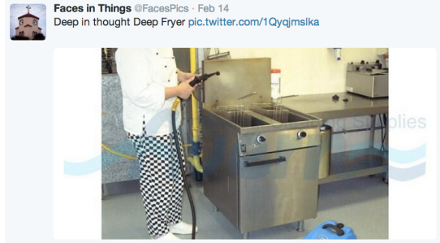
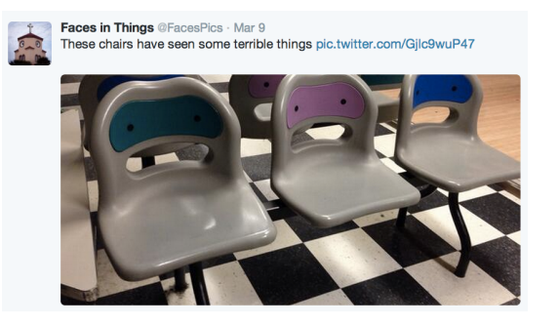
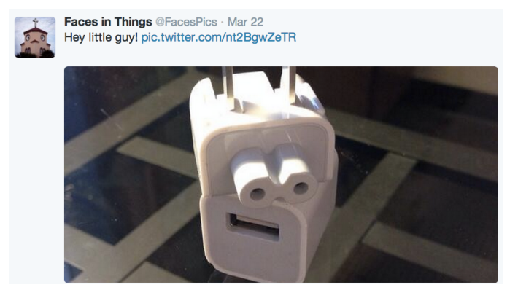
Inappropriate application of priors
Apply priors inappropriately
Pareidoia
We see faces (which our brains are very well trained to see)
Where there aren’t faces

Slide 13
Take home point
Vision is ”constructed” top-down from the input

Slide 14
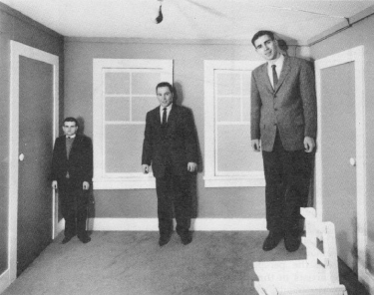
Human visual system
What we see depends on our goals and expectations
This is how some optical illusions work
Relative judgements are strong
Absolute judgements are weak
Who is taller?

Slide 15
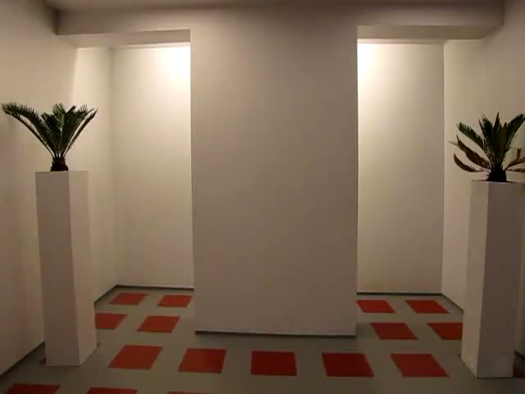
Tricked you!

Slide 16
Size perception
We don’t perceive size absolutely
But in relation to surroundings
Our brains makes a judgement of what the size is, it is not something we just see

Slide 17
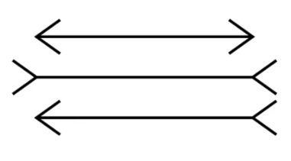
Which line is the longest?

Slide 18
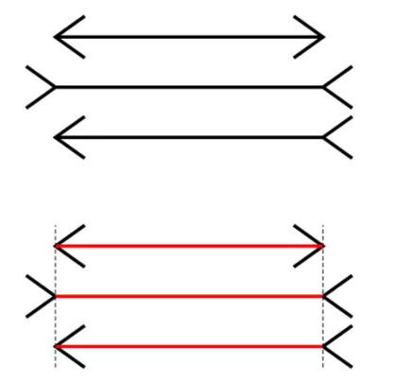
Muller-Lyer Illusion

Slide 19

Which rectangles are the darkest? Lightest?

Slide 20


We don’t perceive colors absolutely But relative to surroundings

Slide 21
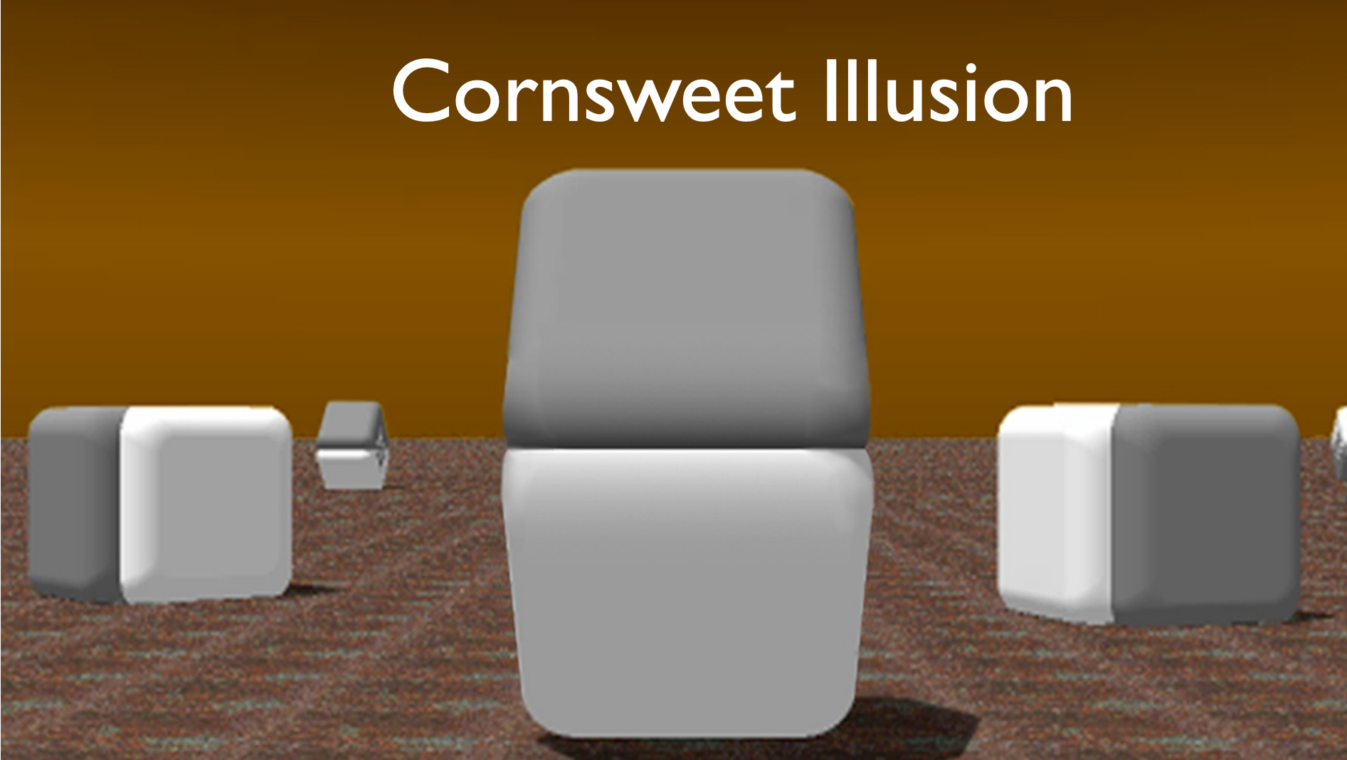
Which is darker?

Slide 22
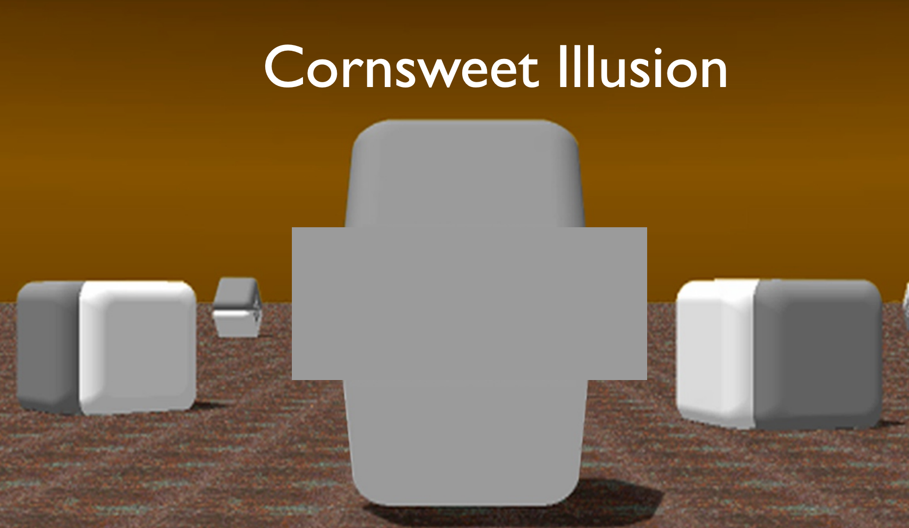

Which is darker?

Slide 23
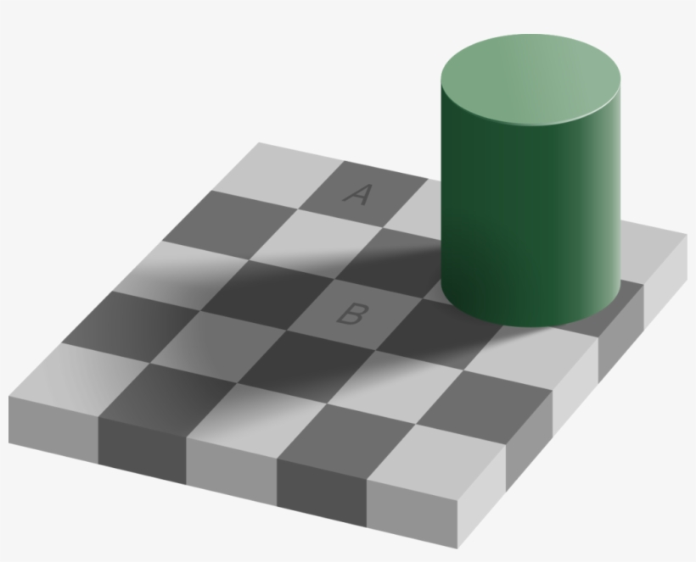
Describe the color of A? B? Dark gray and light gray?

Slide 24
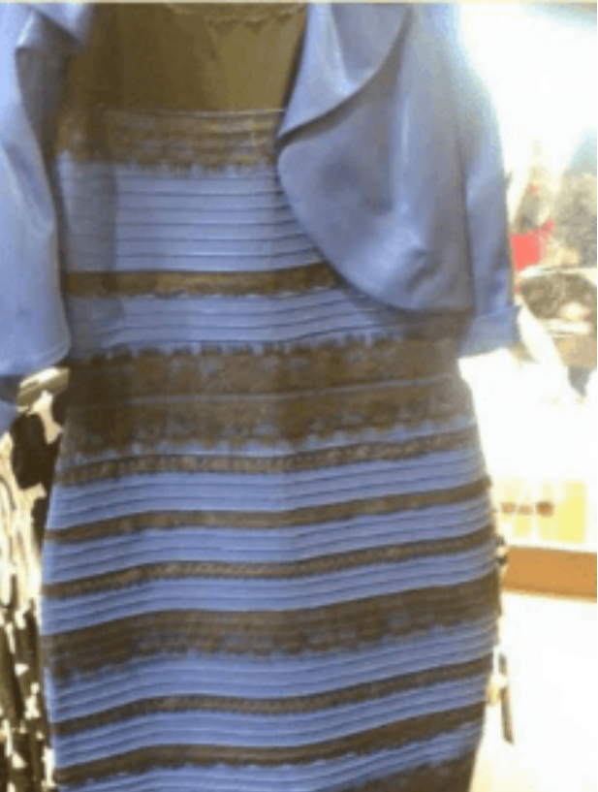
The dress
What colors are in the dress?
Black and blue?
White and gold?

Slide 25
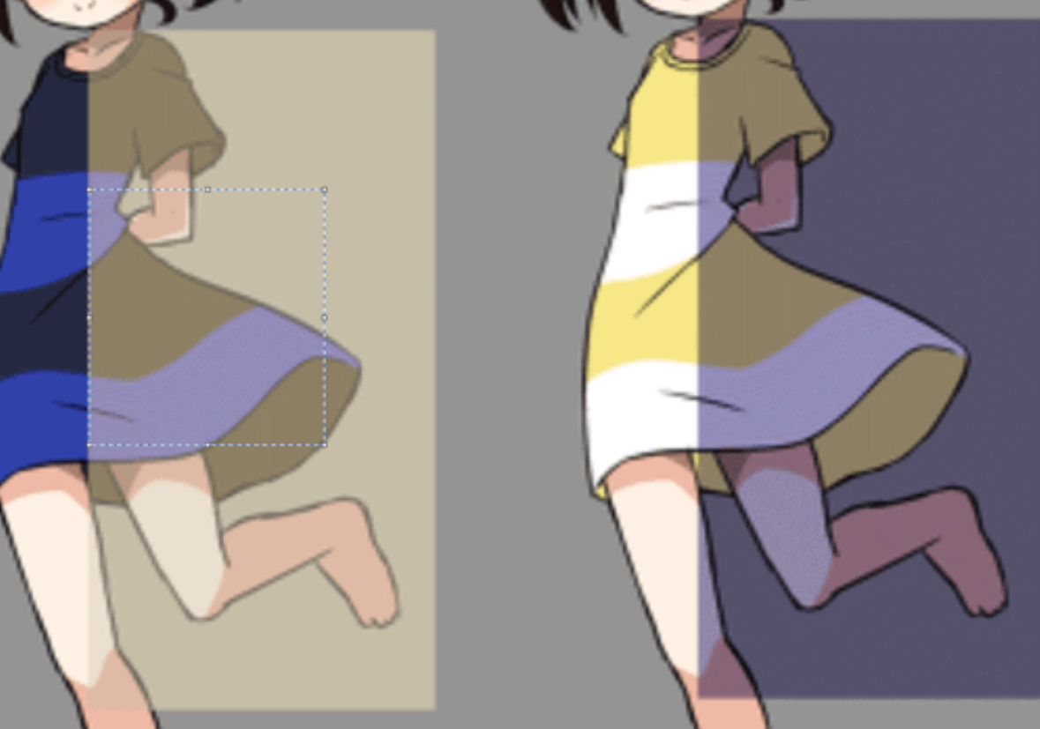
The dress
It actually is blue and black but….
Your brain makes an estimate of the color based on what is perceives to be the lighting in the room
People now study this….
57% blue and black
37% white and gold

Slide 26
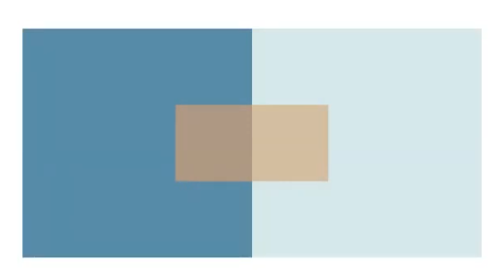
Placement matters in color perception
Close together these colors look different

Slide 27
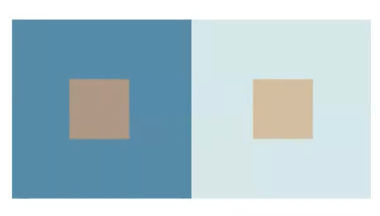
Placement matters
Move them apart, and they look more similar

Slide 28

Influence of background color

Slide 29
How do we see things in the first place?
Is our visual system like a camera?
where all the light comes in, strikes our eye, registers in our brain?

Slide 30
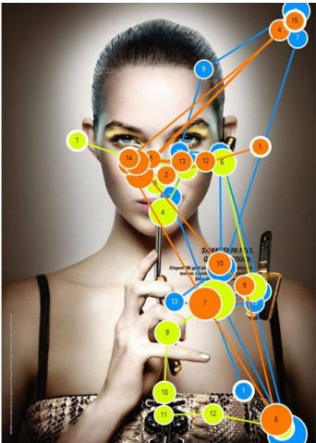
Human visual system
Our experience may feel like vision is like a camera but….
Vision is a sequence of
Fixations- maintain our gaze on a single location (200-600ms)
Saccades- move to a different location (20-100ms)
This is unconscious, happens so quickly you don’t know it is happening
Illustration: eye tracking data- where did someone look if you track their eyes

Slide 31
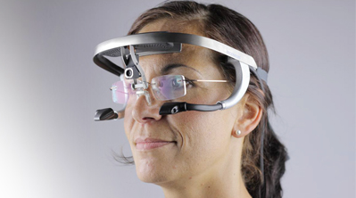
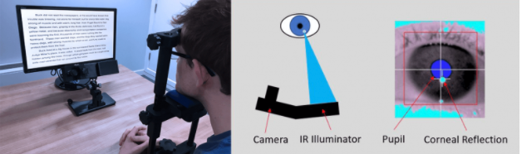
Eye tracking

Slide 32
Example of where we are looking
https://www.youtube.com/watch?v=DIEO0ZHgLSU

Slide 33
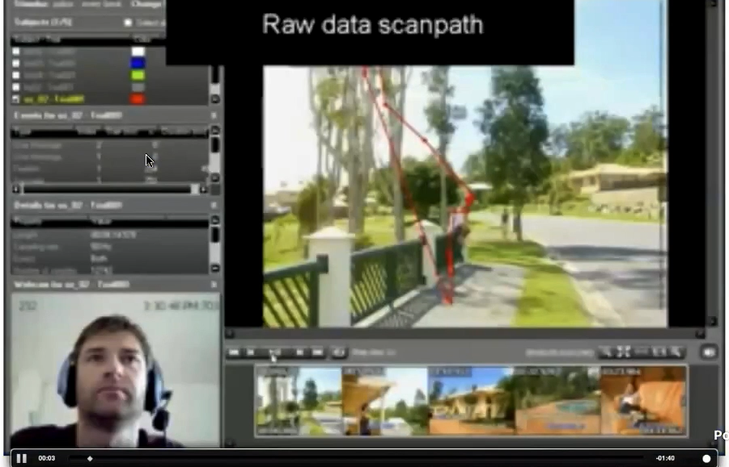
Eye fixations and reading

Slide 34
How is this relevant
You can study eye movements and visual interfaces
Ensure that users are seeing what they want them to see
Good to know that we aren’t registering the whole picture uniformly
Reason to think about how to organize content
How do we draw a user’s attention

Slide 35
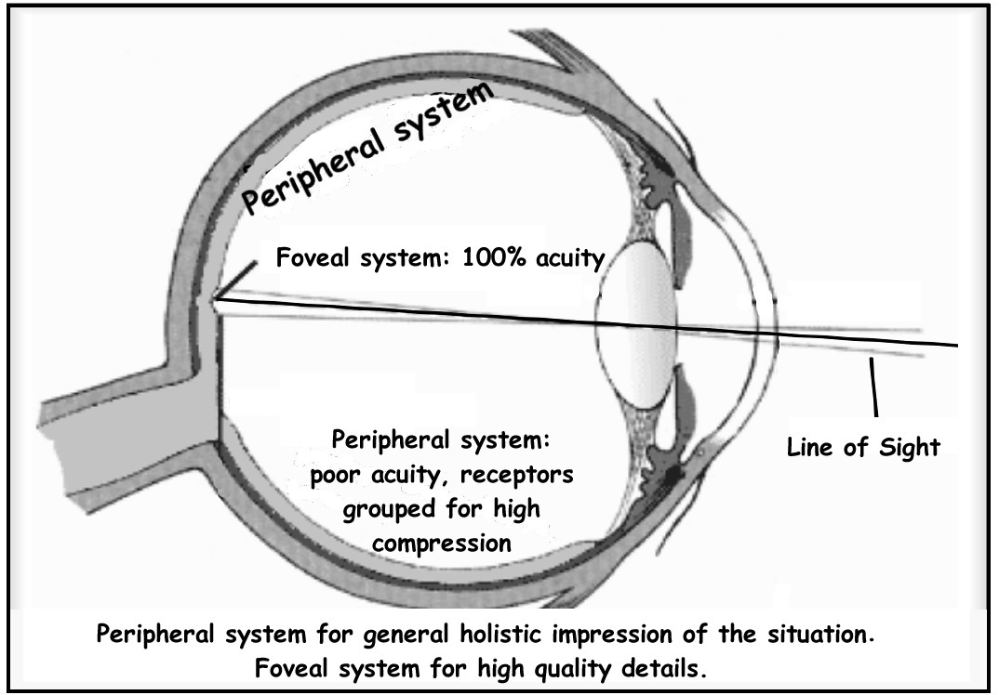
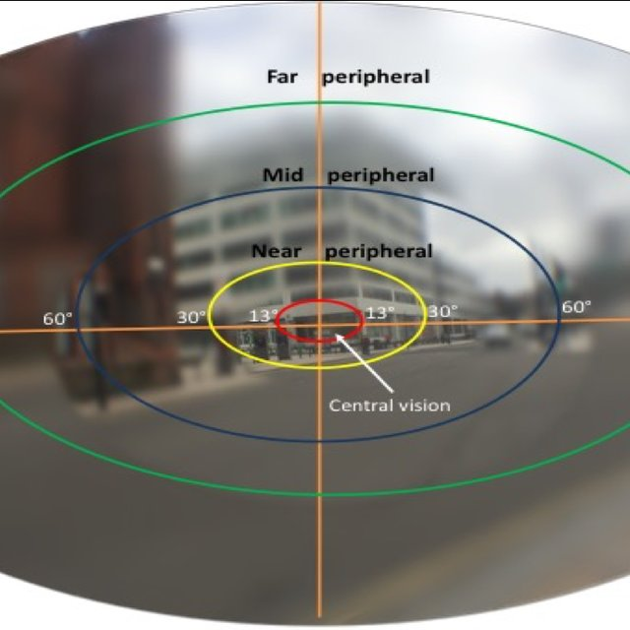
Central and peripheral vision
Vision can be separated into central and peripheral vision
Central vision looks directly at objects
Peripheral vision is used to grab attention, and responds strongly to movement
If we want the user to concentrate on a particular task or area, no flashing elements to distract them in their peripheral vision
Distracting
Or- if you want to grab the user’s attention, can use color and movement

Slide 36
Change blindness
Door study https://www.youtube.com/watch?v=FWSxSQsspiQ
Gradual change test https://www.youtube.com/watch?v=1nL5ulsWMYc

Slide 37
Attentional blindness
https://www.youtube.com/watch?v=vJG698U2Mvo

Slide 38
Implications for UI
We don’t notice changes
We can’t attend to everything
Don’t assume the user will see a change in your interface
You need to design to visually attract their attention
Flashing elements
Transitions
Auditory cues

Slide 39

Faces
We are wired to pay special attention to faces
We recognize and react to faces faster than other types of objects
We look where a face looks
We may not be conscious of seeing the object
Use faces to attract and direct attenton

Slide 40
We talked previously about different visual channels for design
Let’s dig into which are stronger

Slide 41
Experiment
Let’s test how quickly you detect the target when surrounded by distractors
This is going to be a bit difficult to measure, because it is fast, but just for illustration…
Clap when you spot the target

Slide 42
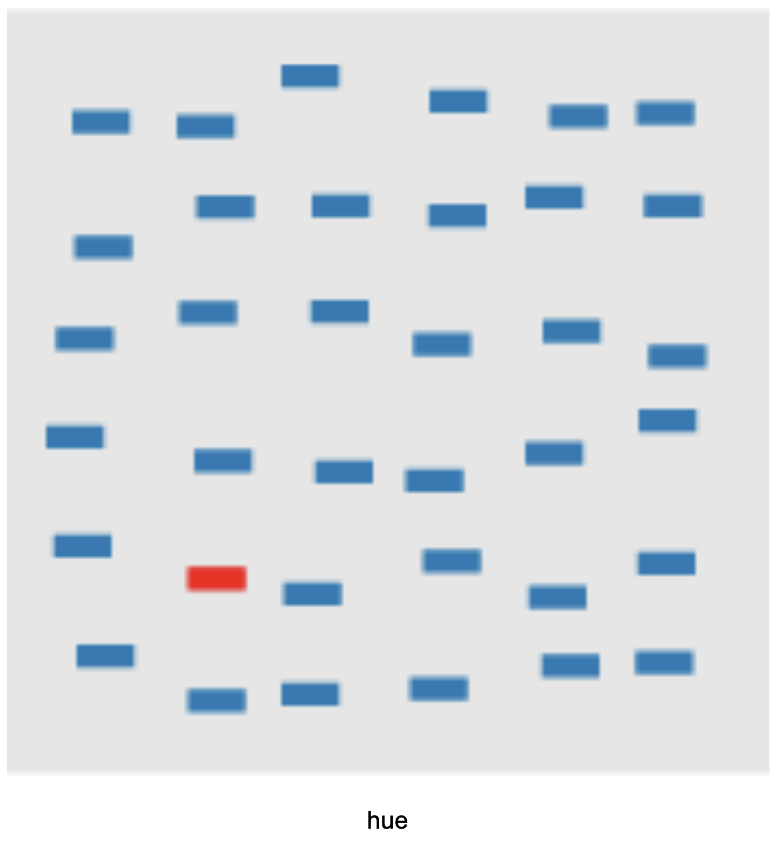
Hue

Slide 43
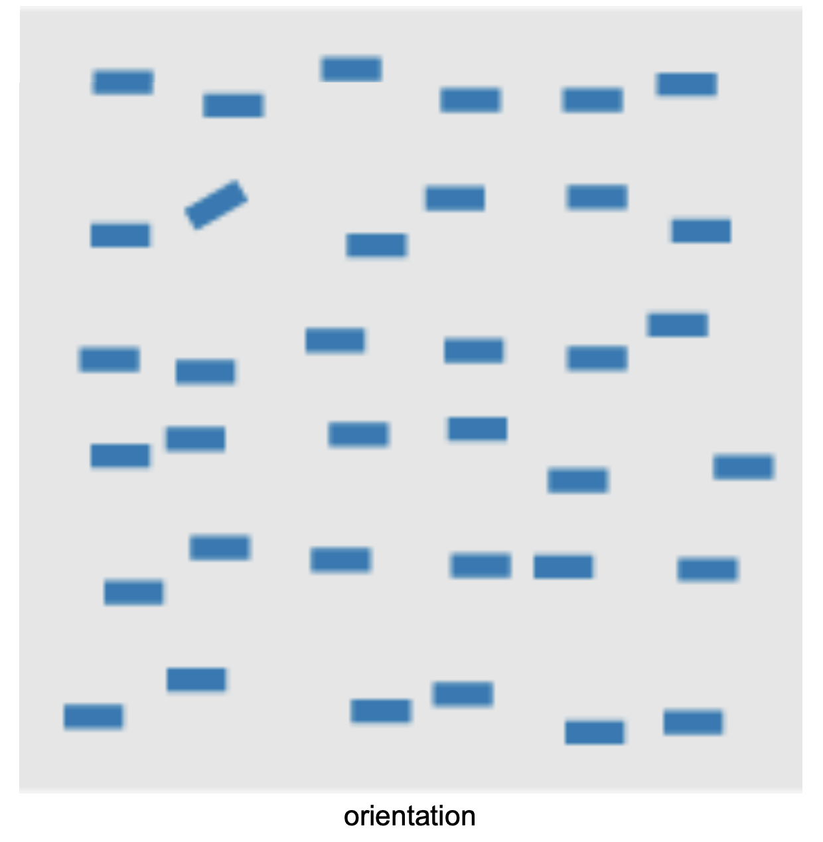
Orientation

Slide 44
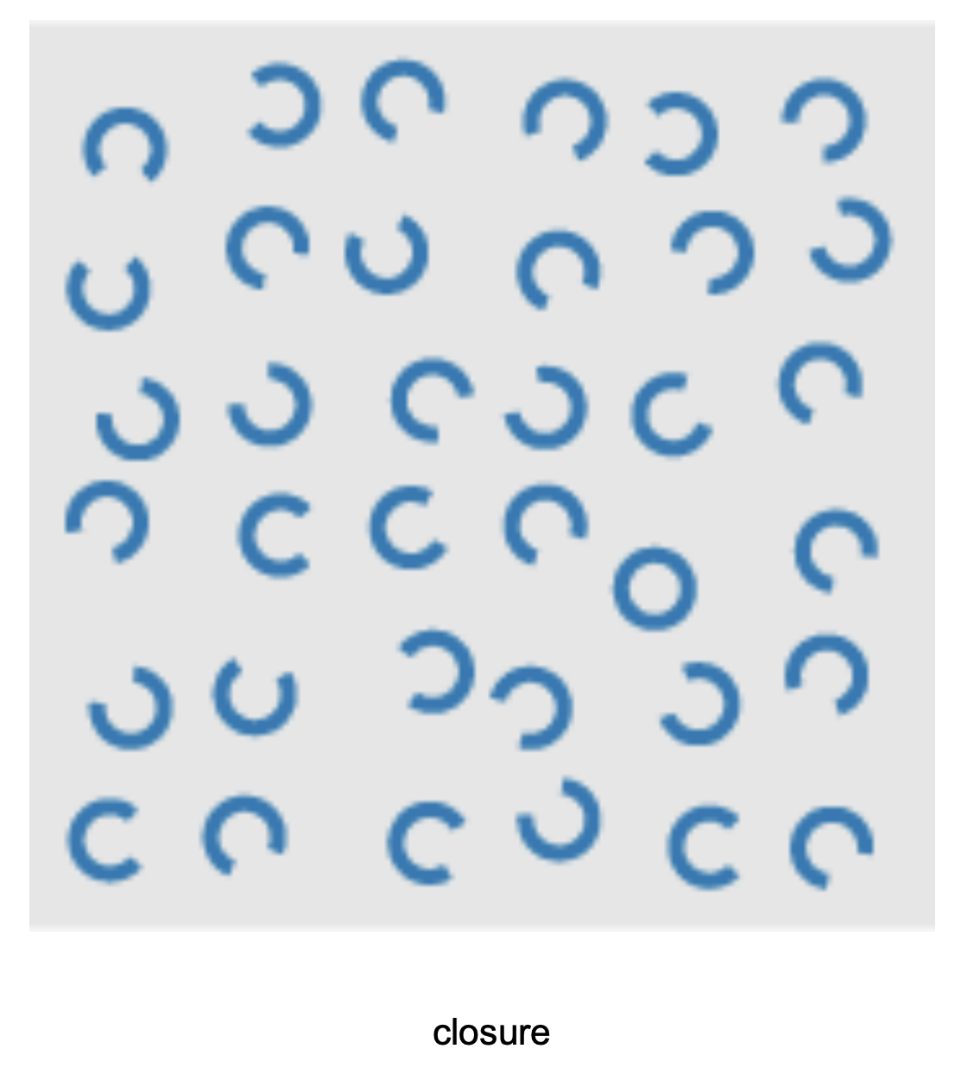
Closure

Slide 45
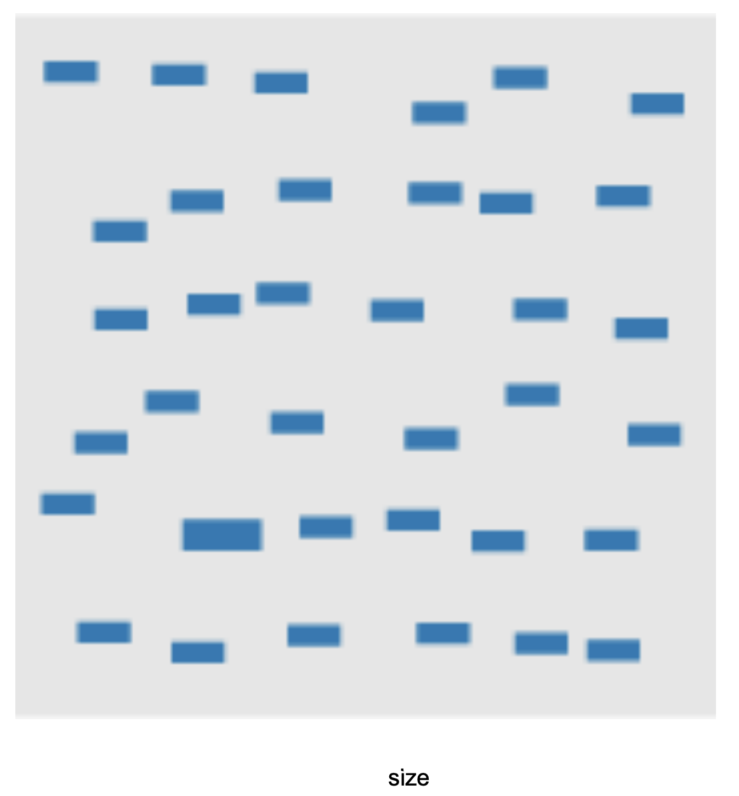
Size

Slide 46
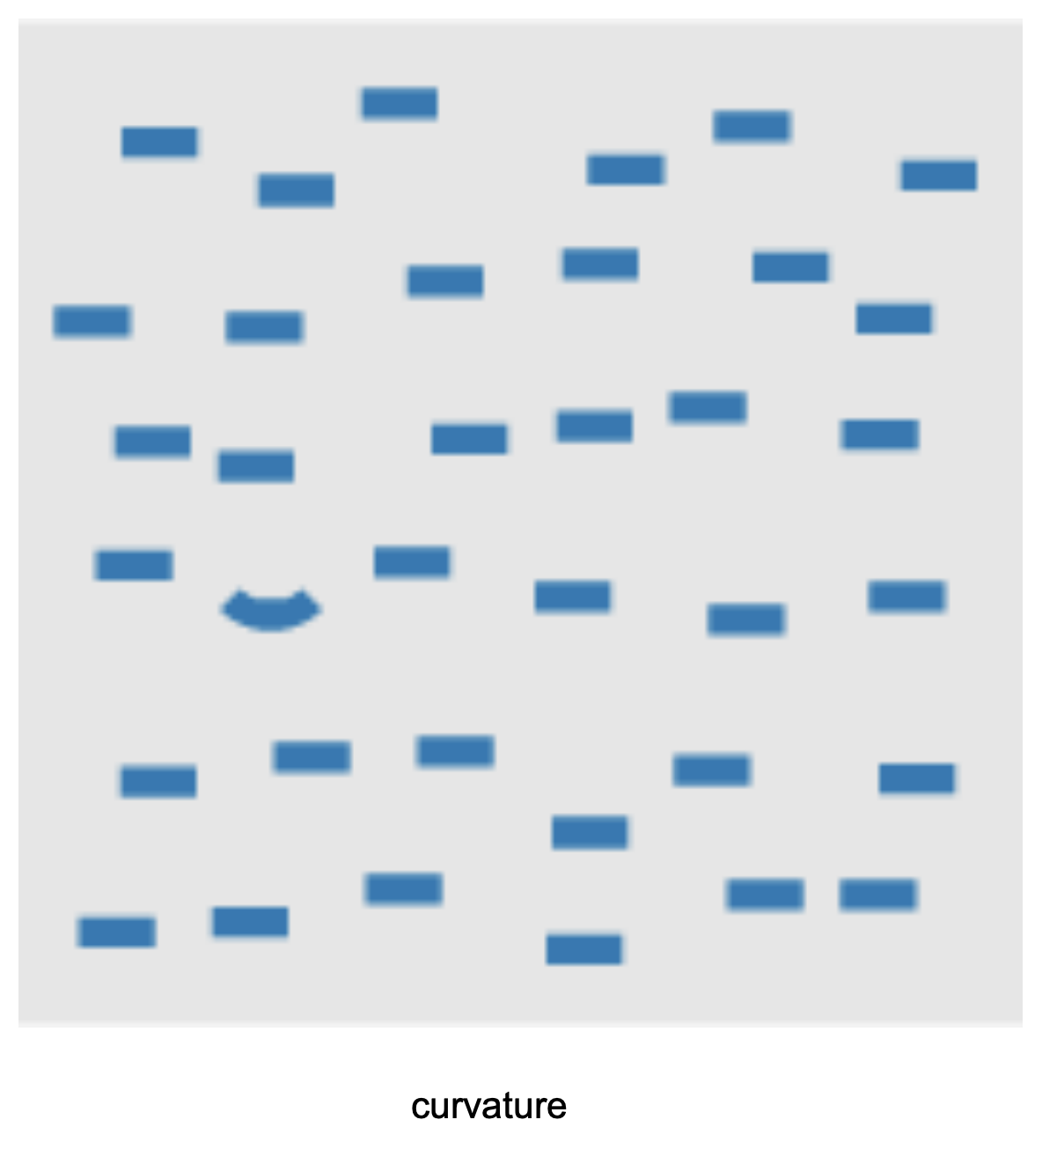
Curvature

Slide 47
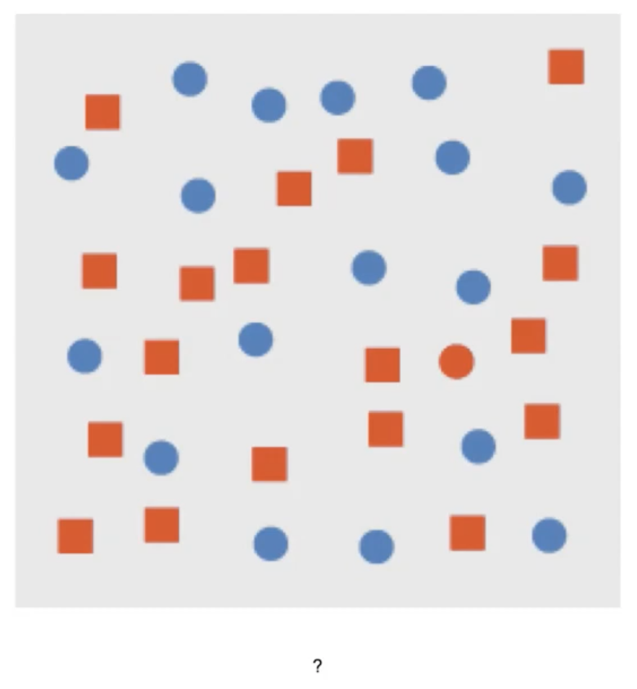
?

Slide 48
Combination
All circles are blue
All rects are red
Except our target: a red circle

Slide 49
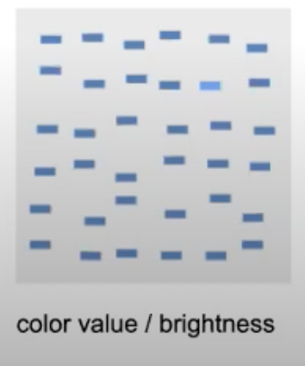
Brightness

Slide 50
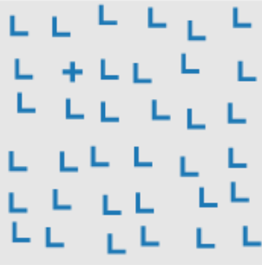
Intersection

Slide 51
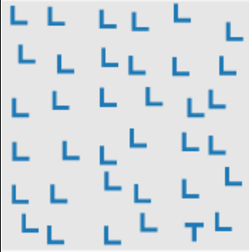
Terminators

Slide 52
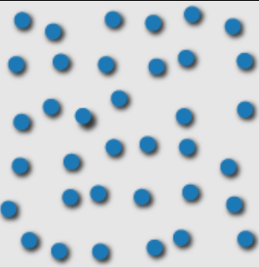
3D depth cues

Slide 53
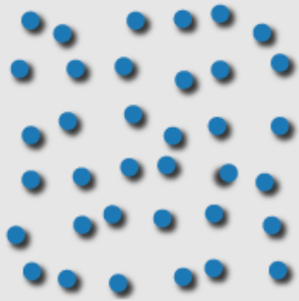
Lighting direction

Slide 54
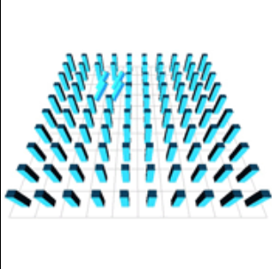
3D orientation

Slide 55
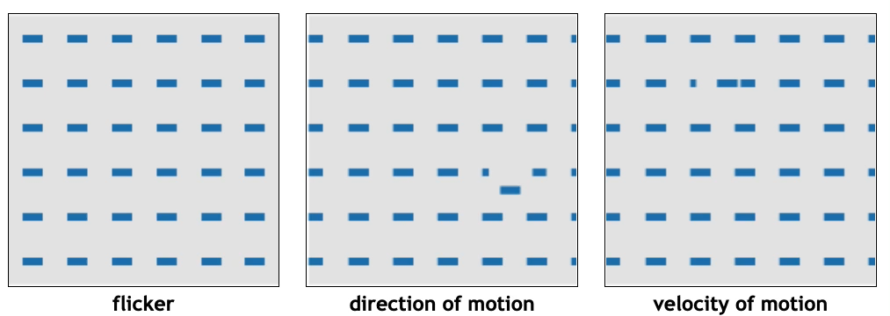
Animations

Slide 56
Some of these were faster, more accurate than others…

Slide 57
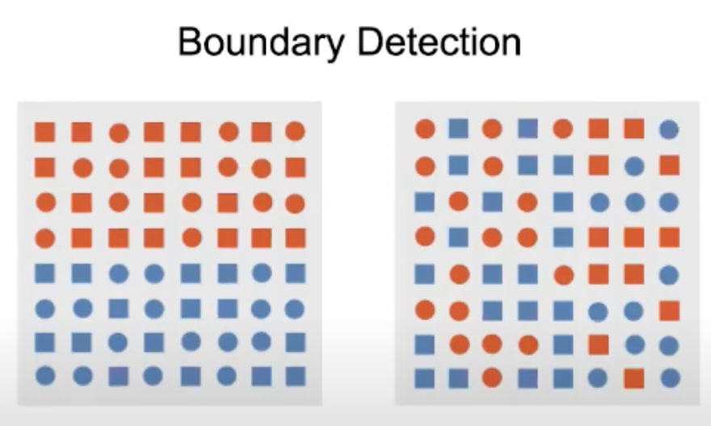
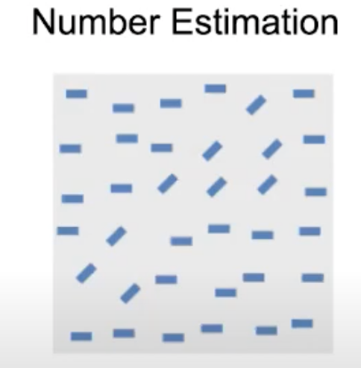
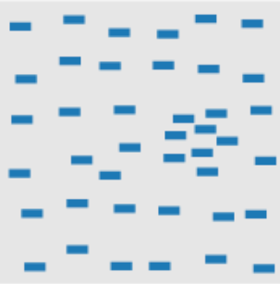
Perception, visual properties and tasks
Target detection
Detect the presence or absence of a target
Boundary detection
Identify the boundary between two groups of elements- with elements in each group having a common visual property
Number estimation
How many targets with a unique visual element
Density estimation

Slide 58
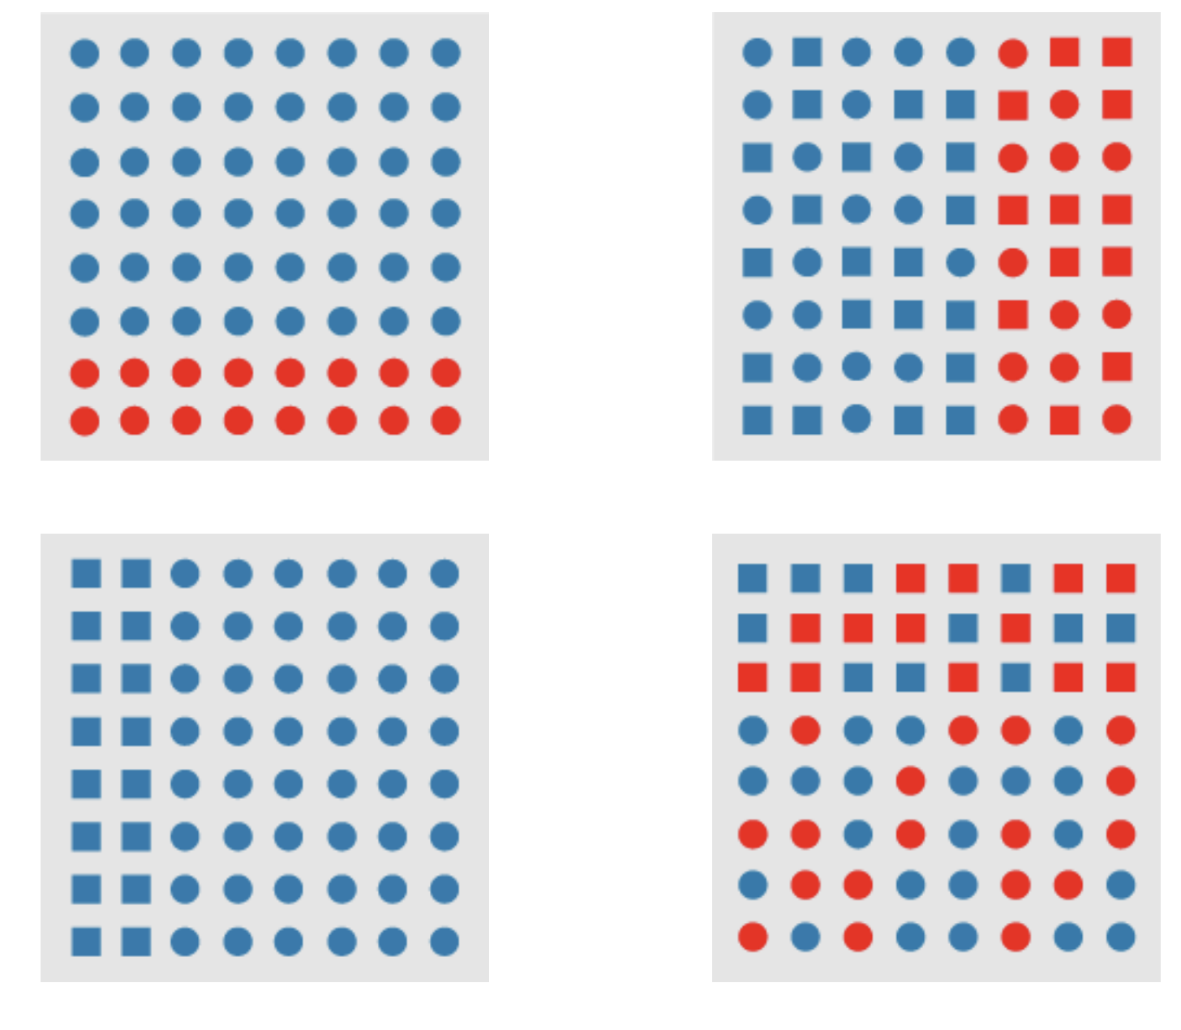
Comparing visual features- which is stronger for a task?
Some visual features are stronger for a
particular task
(Eg. Boundary detection with hue vs shape )

Slide 59
Activity today- project 1 related
Get together in a group with people working on your smart object
Discuss:
What is one thing about the project you are unsure about
Are you stuck on something?
Were you recently stuck on something and got ‘un-stuck’? How?
What part of the project do you think will take the longest?

Slide 60
Credits
PhD Comics
XKCD
University of Utah Visualization Course, Alex Lex
University of British Columbia Visualization Course, Tamara Munzner
New York Times

Slide 61
Credits
https://www.youtube.com/watch?v=X1Q4IKvE5cA&list=PL3sGw6DVKZGgv_ulhumGVLp1OqN-esKtv&index=2&t=24s

